Slide 1

Intellitest
Using AI Models and Testing

Slide 2

Introduction
We are the IntelliTest team - passionate Computer Science students working to make software testing smarter, faster, and easier through AI, so we decided to create Debuggo.
Debuggo is an AI-powered software testing extension that generates intelligent test cases and runnable test code directly inside the developer’s IDE, helping teams save time, reduce manual effort, and improve software quality.

Slide 3
Live Demo

Slide 4
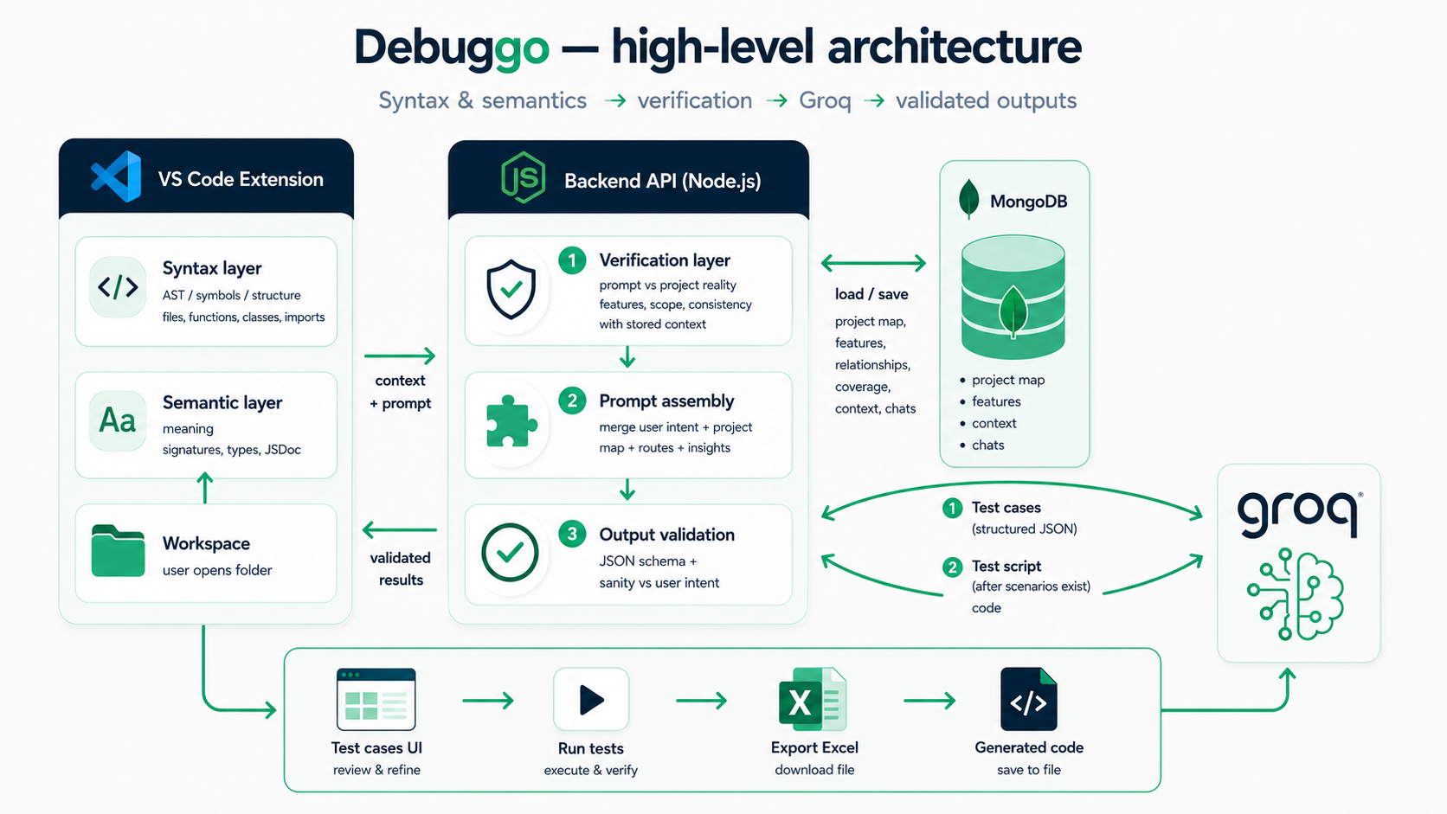
High Level Architecture

Slide 5
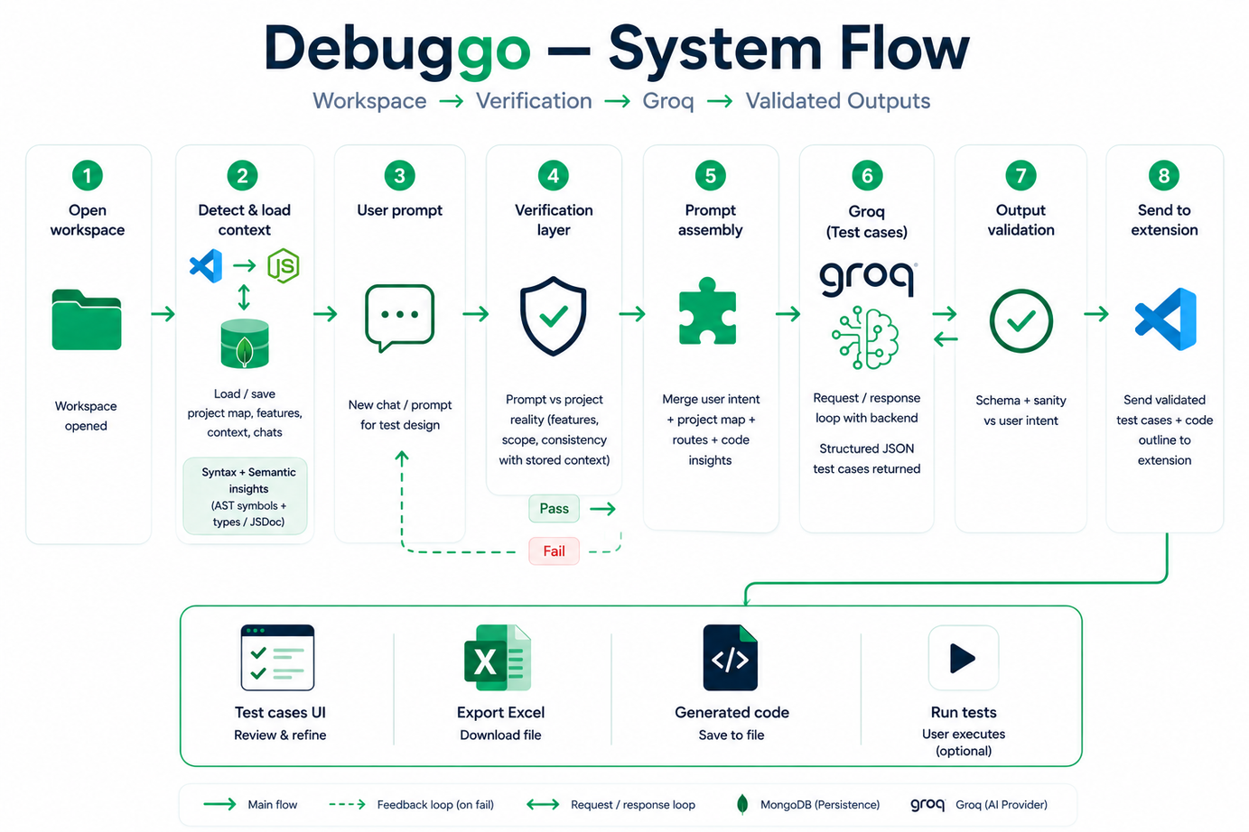
System Flow

Slide 6
Constraints & Limiations
Tried integrating models through Hugging Face, OpenRouter, and DigitalOcean
Approaches using separate models like Qwen and DeepSeek were not effective for our workflow
Final implementation used Groq with Few-Shot Prompting for structured test case generation

Slide 7
Future Plans
Test Code Execution & Status Marking IN Excel.
Be in more IDEs like Cursor, WindSurf, AntiGravity.
Test Coverage Report

Slide 8
Conclusion

Slide 9
Thank You
Questions?

